Slide 1

Sesi 12 Writing a letter from a short story of harry potter
Team English Teaching unsia

Slide 2
LEARNING OBJECTIVES
After learning this session
Able to understand about concept of writing a letter in formal and informal to your family, friends, teacher, principal, etc.
Able to understand about vocabulary in a letter

Slide 3
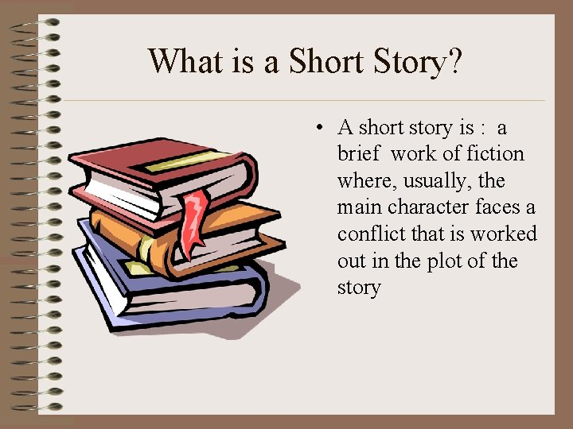

Slide 4

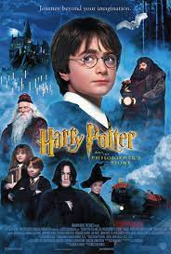
Here is the video you can look at about Harry Potter. It takes about 14 minutes more.
https://www.youtube.com/watch?v=nnD8FKXzIGs

Slide 5
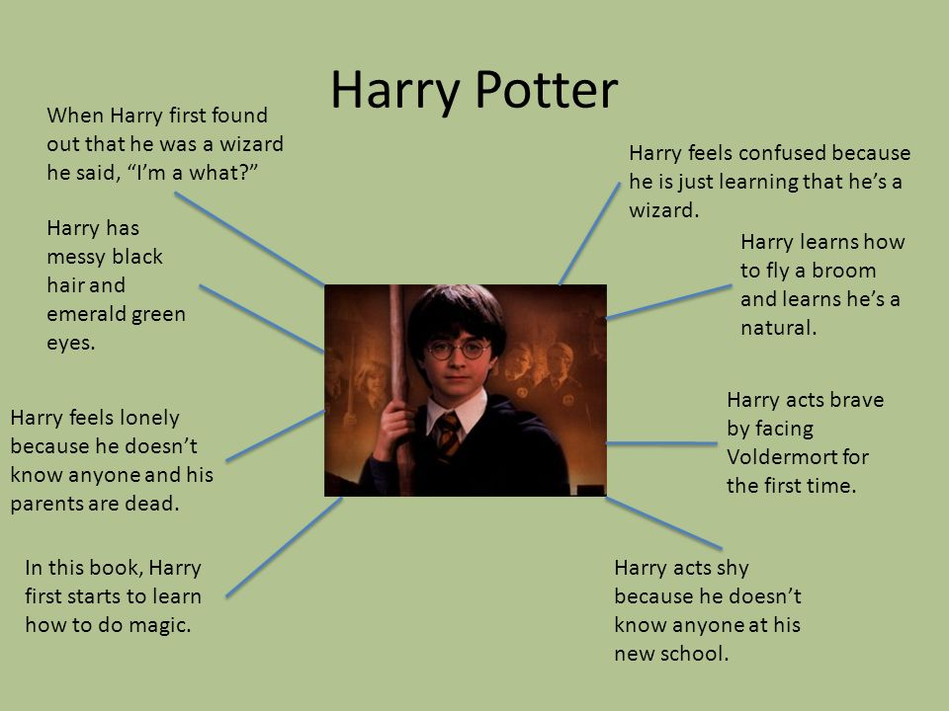
CHARACTERS OF HARRY POTTER
Messy black hair
Emerald green eyes
Feels lonely
Brave
Shy
Confused

Slide 6
What is a letter
Letter is a mean of communication, that contains a text message, which can be handwritten, typed or printed, sent by one person to another, via email or post, so as to inform, complain, report, enquire or request something.
There are 2 types in letter
Formal letter
A formal letter is a letter written to a business, a college, or any professional
Informal letter
An informal letter is a letter you would write to a friend or family

Slide 7
IMPORTANCE OF LETTER
Letters represented your company’s public image and your competence
Letters are more personal than a report, yet more formal than memos or e-mail
Letters are more permanent than e-mail
Letter constitute an official legal record of an agreement
Letters follow up on telephone calls and other types of oral communication
Letters provide a wide range of corporate information
Letters can support action
Letters sell
Letters are efficient for targeted

Slide 8
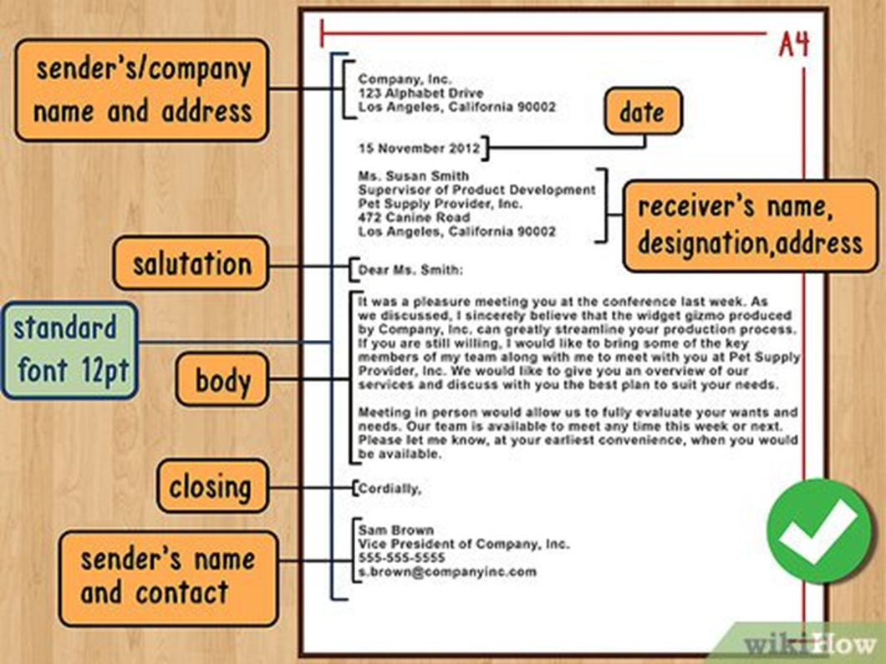
Part of a letter

Slide 9
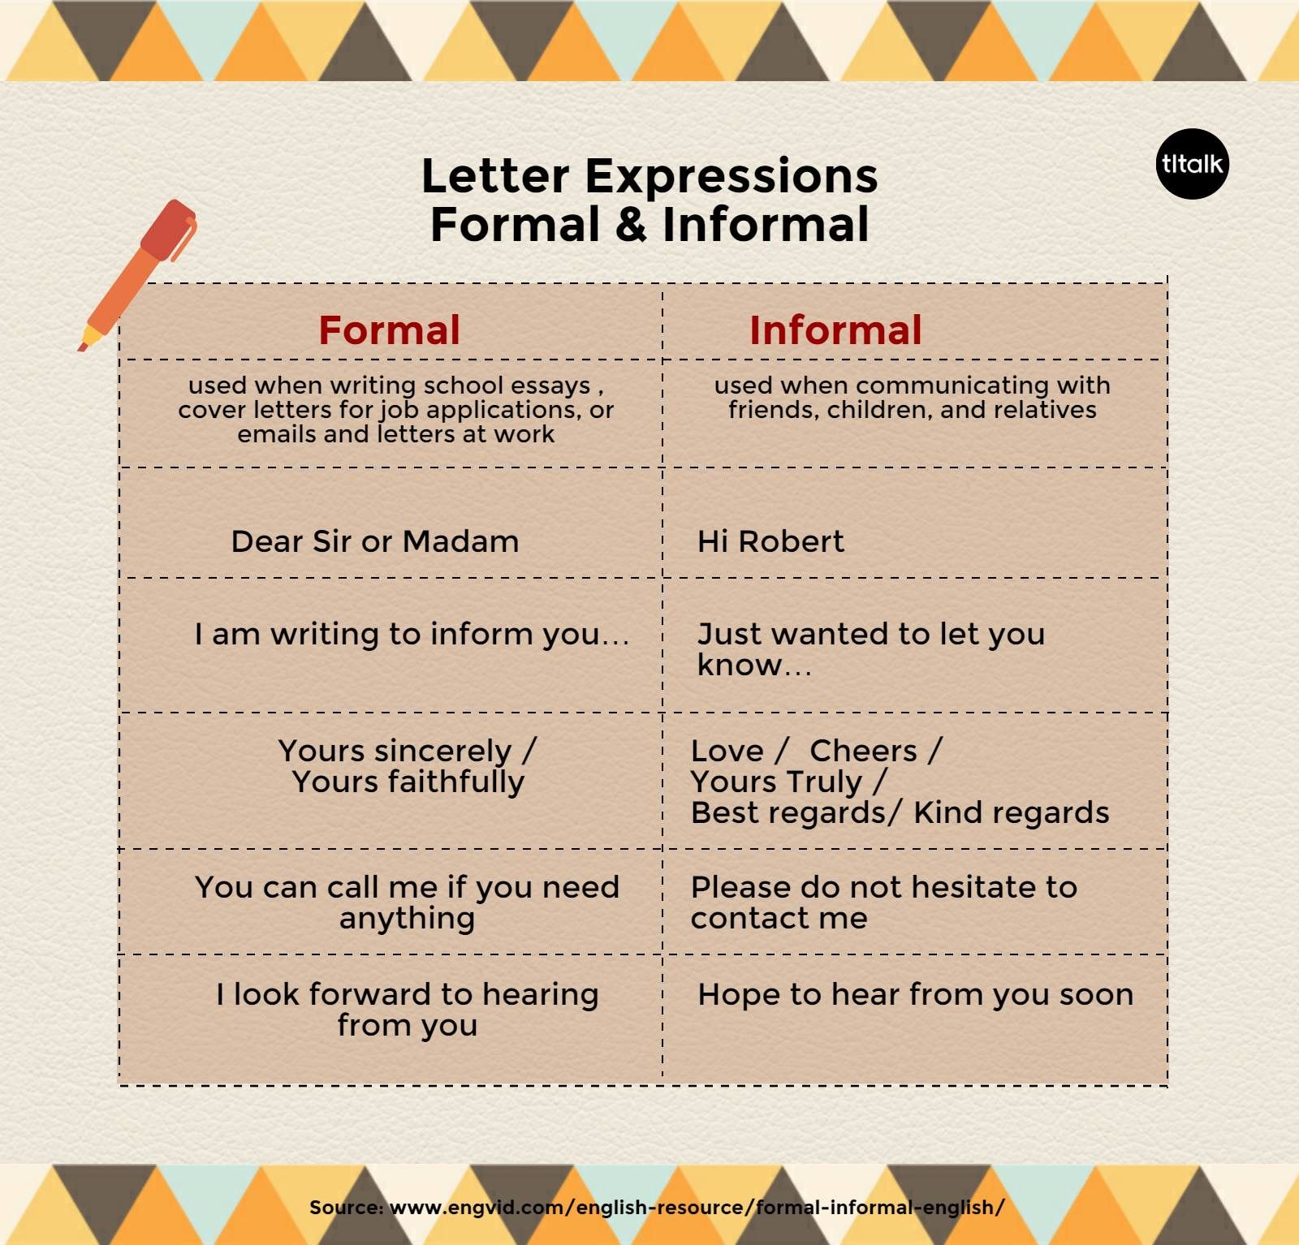
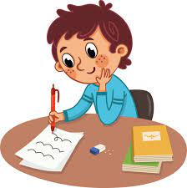

Slide 10
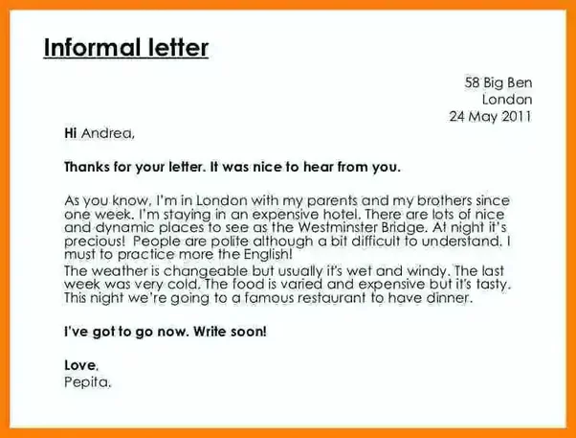

Slide 11
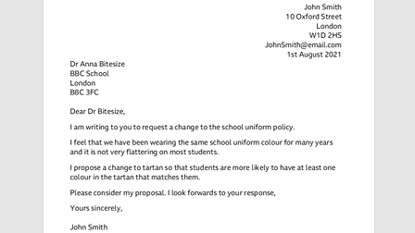
Example Formal letter

Slide 12
Conclusion
It is very important to write business letters correctly because your success in business depends on how people understand your wishes and needs. Your first letter is an impression you make on your new partner. To be successful in business one must make contacts in the written from in a right way.
A correct letter makes a right head

Slide 13
Practice :
Write a letter for Harry Potter
The letter will talk about “How was school so far Harry Potter?”

Slide 14


